Slide 1

មហាវិទ្យាល័យ ព័ត៌មានវិទ្យា និង វិទ្យាសាស្រ្ត FACULTY OF INFORMATION TECHNOLOGY AND SCIENCE
MAJOR: SOFTWARE ENGINEERING
SUBJECT: SOFTWARE PROJECT MANAGEMENT
TOPIC: “AI TRAVEL GUIDE CHATBOT FOR CAMBODIA”
FINAL PROJECT
LECTURER PROFESSOR DR. SOVANN CHEN

Slide 2





SUBMITTED BY GROUP 4
Mr. TOB CHENDA
Mr. TEP VANNY
Mr. VAN SARATH
Mr. PHAN CHHAYLEAP
Mr. YI PHANIT

Slide 3
Mr. TOB CHENDA
Project Manager
& Developer
Mr. TEP VANNY Marketing Officer
Mr. VAN SARATH
UI/UX Designer
Frontend Developer
Mr. PHAN CHHAYLEAP
System Analyst
Backend Developer
Mr. YI PHANIT
Tester (QA)

Slide 4

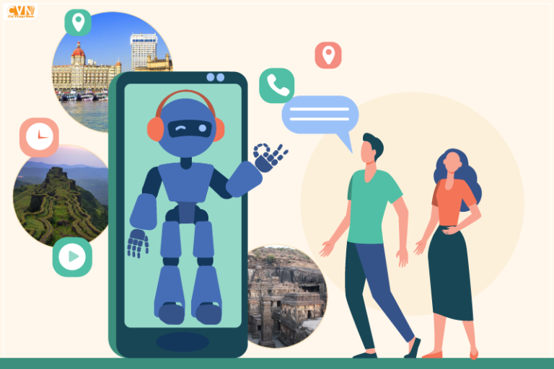
“AI TRAVEL GUIDE CHATBOT FOR CAMBODIA”
25–December- 2025
vannymanuel333666999@gmail.com

Slide 5

CONTENT
01
07
PROBLEM STATEMENT
TESTING RESULTS
02
08
PROPOSED SOLUTION
CHALLENGES & SOLUTIONS
03
KEY FEATURES
09
CONCLUSION & FUTURE SCOPE
04
TECHNOLOGY STACK
05
SYSTEM ARCHITECTURE DIAGRAM
06
DEMO

Slide 6

1. PROBLEM STATEMENT (WHY DID WE BUILD THIS?)
WHY DID WE BUILD THIS?
Tourists visiting Cambodia face difficulties finding accurate, reliable, and localized travel information
Existing travel platforms are:
Difficult to navigate, with scattered information across multiple pages.
Not focused specifically on Cambodia, lacking deep local insights.
International tourists experience language barriers, making it hard to understand local guidance.
There is no 24/7 intelligent assistant to instantly answer tourist questions.
As a result, tourists spend more time searching for information and may miss important travel opportunities

Slide 7
2. PROPOSED SOLUTION (High-level overview)
This project is an AI-powered travel guide chatbot that assists domestic and international tourists with travel information by:
Recommending places in Cambodia (Angkor Wat, Phnom Penh, Siem Reap, beaches, cultural heritage sites, and natural attractions, etc.).
Giving travel tips (transport, food, culture, weather, safety)
Answer tourists' questions using English (and optionally Khmer)
Provide 24/7 instant responses to users
Improve tourist experience and satisfaction
Accessible via web or mobile application
Easy-to-use and user-friendly interface
Promote Cambodia’s tourism industry using modern AI technology
To address these problems, this project proposes the development of an AI Travel Guide Chatbot for Cambodia that provides instant, accurate,
and personalized travel information using Artificial Intelligence.

Slide 8
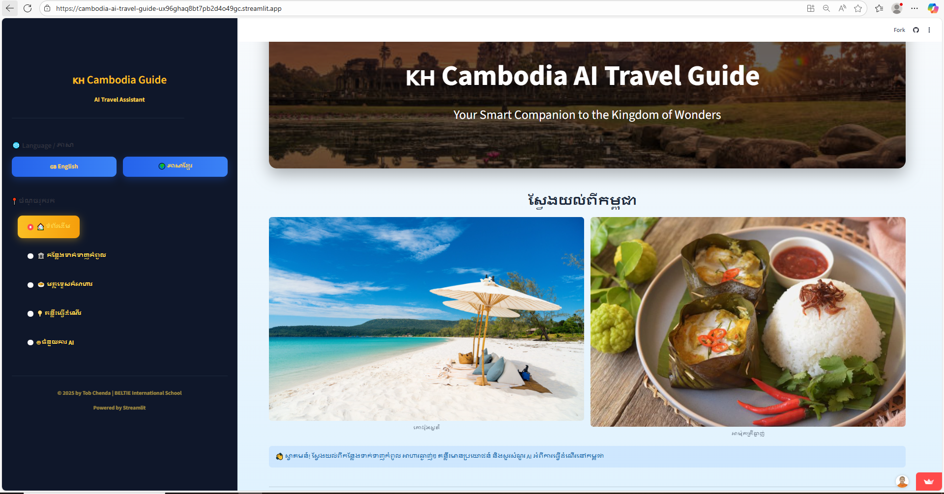
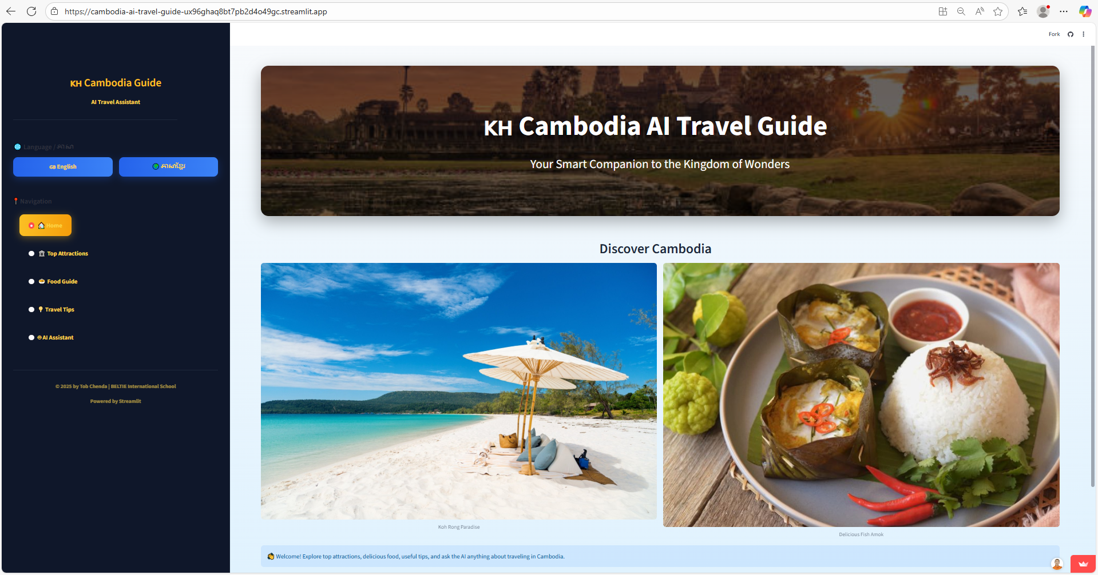
3. KEY FEATURES
In-Scope Features
1. Language Support
English
Khmer
Enables communication for both international and local tourists
Helps reduce language barriers
2. Home Page
Simple and user-friendly interface
Quick access to main features
Highlights popular destinations and chatbot access

Slide 9
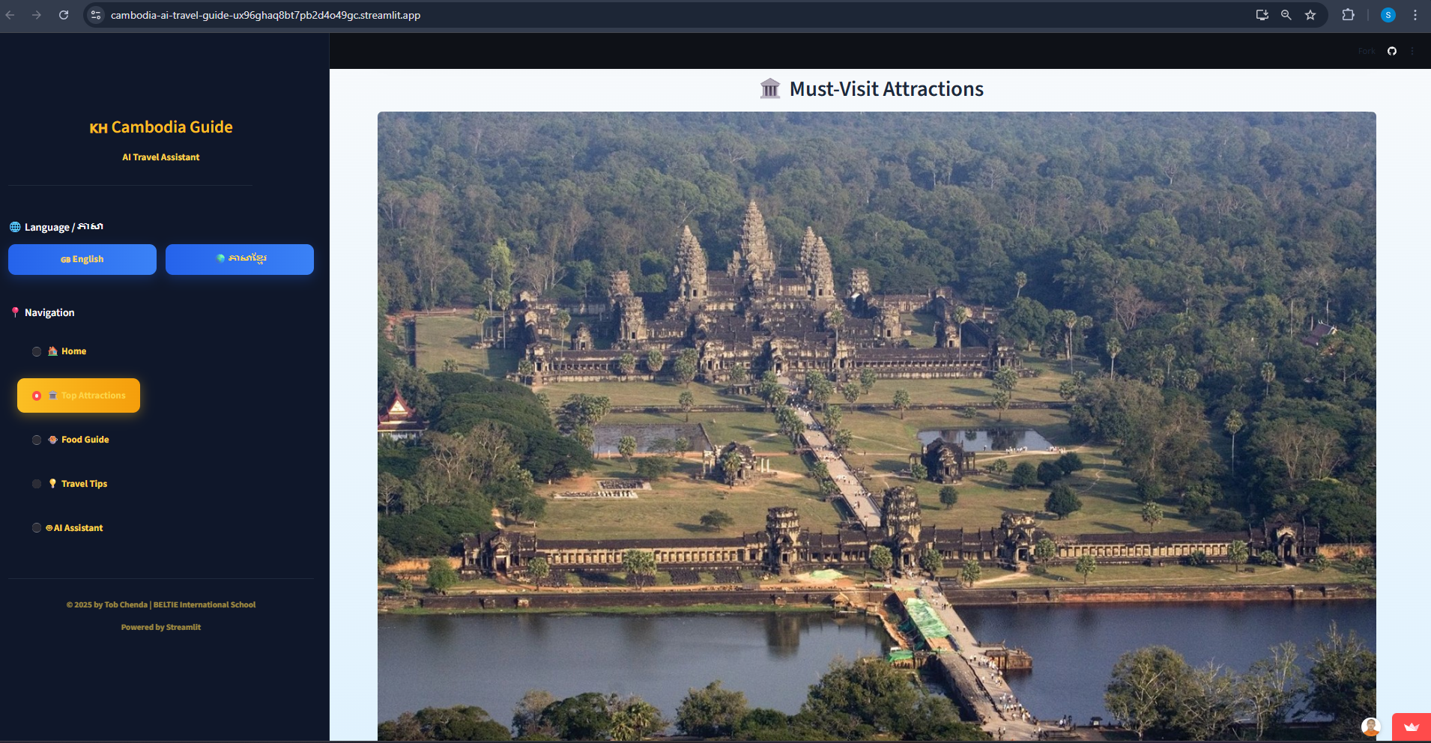
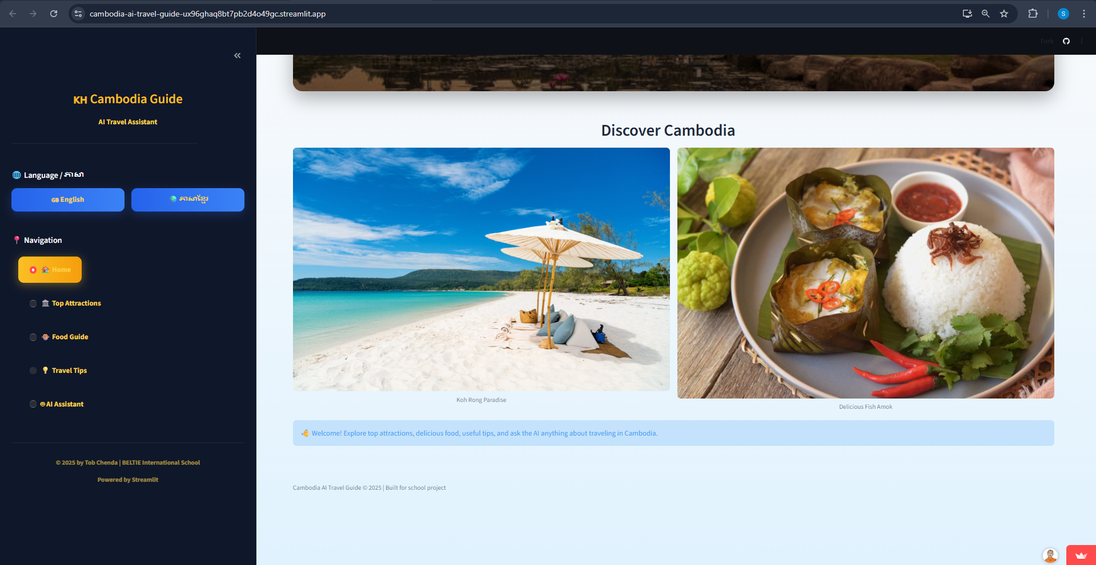
3. KEY FEATURES
3. Tourist Top Attractions
Recommends popular places in Cambodia, including:
Angkor Wat
Phnom Penh
Siem Reap
Beaches (Sihanoukville, Koh Rong, etc.)
Cultural heritage sites
Natural attractions
Provides brief descriptions and travel information
4. Food Guide
Suggests popular Cambodian foods:
Amok
Lok Lak
Bai Sach Chrouk
Street food and walk street recommendations
Includes food descriptions and where to try them
Helps tourists explore local cuisine safely

Slide 10
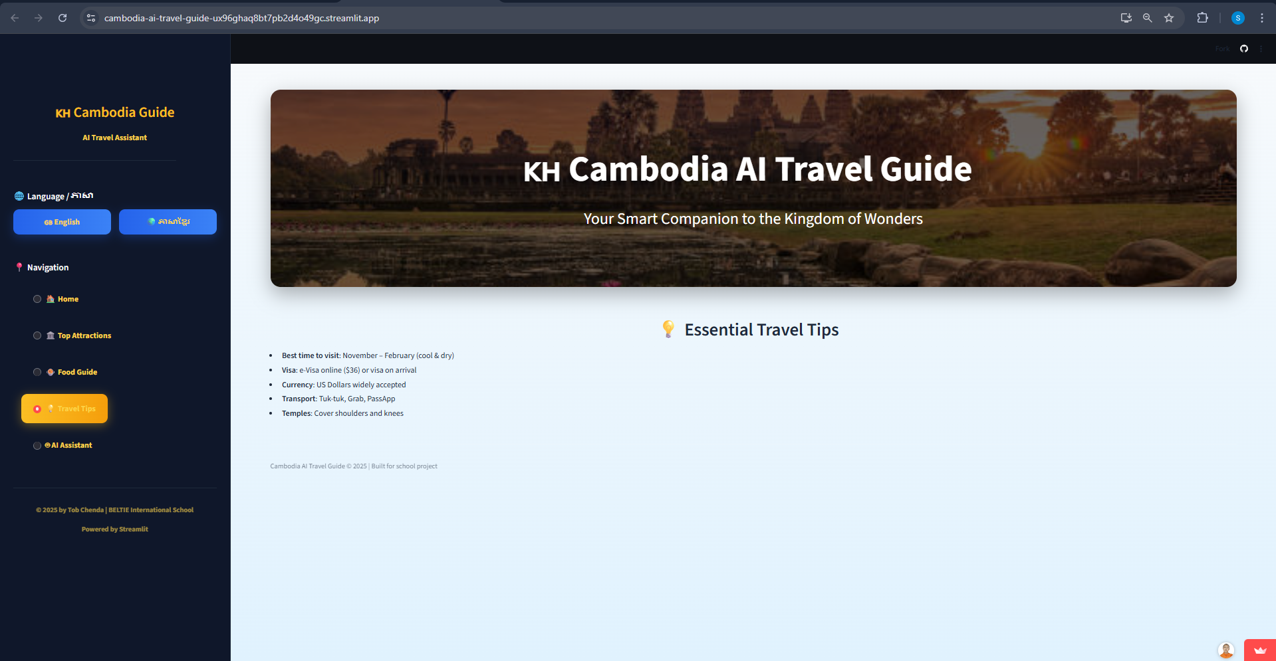
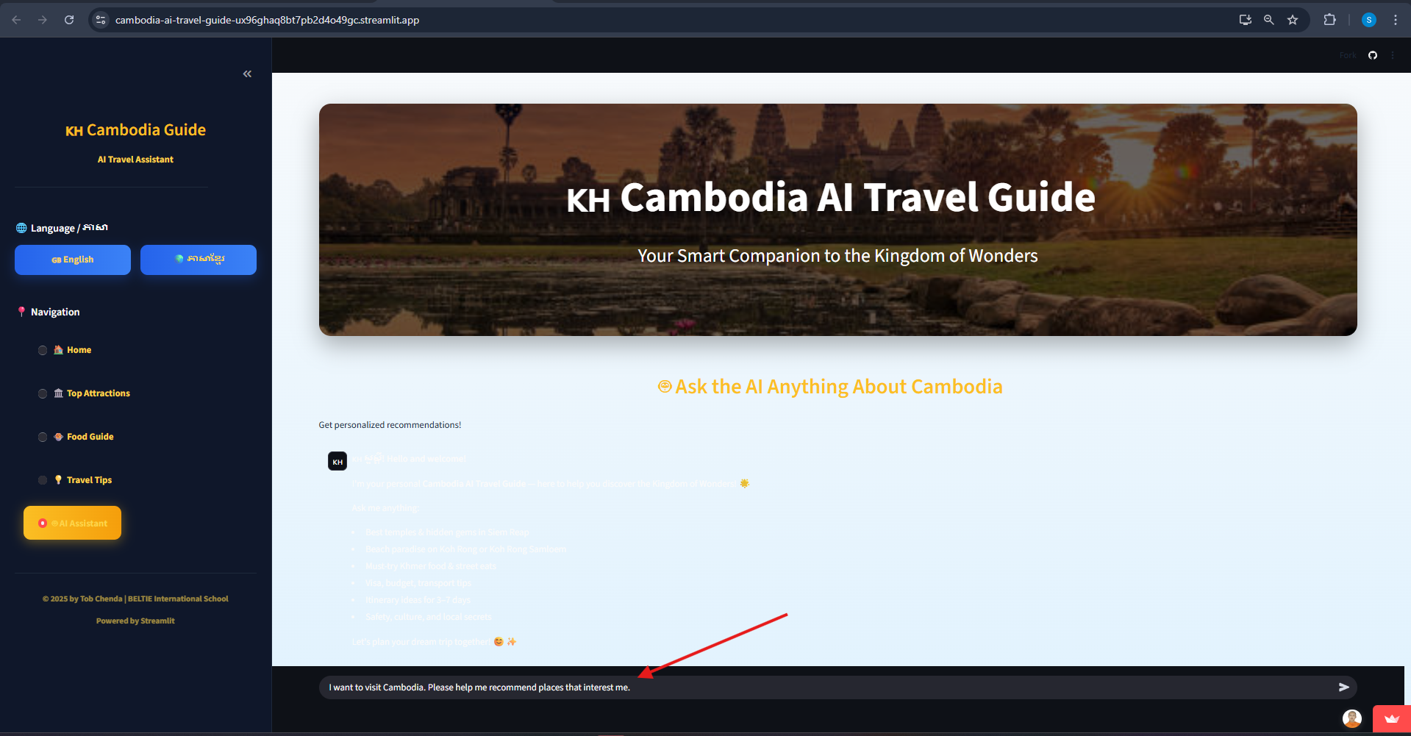
3. KEY FEATURES
5. Travel Tips
Transportation guidance
Weather and best travel seasons
Cultural practices and etiquette
Safety tips for tourists
Currency and basic local information
6. AI Assistance
AI-powered chatbot available 24/7
Answers travel-related questions instantly
Provides personalized recommendations
Supports natural language conversation

Slide 11
4. TECHNOLOGY STACK
Frontend
HTML CSS Used to build a responsive and interactive user interface for the chatbot.
Backend
Django (Python) Handles API requests, chatbot logic, and communication with the AI service.
Database database: PostgreSQL
🗄️ SQL Stores travel information, user queries, chat logs, and system data.
AI / NLP Component
🤖 AI / NLP Engine Processes user input and generates intelligent responses.
Development Tools
🛠️ VS Code – Code editor
🔧 Git & GitHub – Version control

Slide 12
5. SYSTEM ARCHITECTURE DIAGRAM
3. Backend Server (Django)
Handles business logic
Processes user requests
Manages communication between:
Frontend
AI / NLP Engine
Database
4. AI / NLP Engine
Understands user queries
Generates intelligent responses and recommendations
Supports multilingual interaction (English–Khmer)
5. Database (SQL)
Stores:
Tourist attractions
Food guides
Travel tips
User preferences
Chatbot conversation logs
Components
1. User (Tourist)
Accesses the system via Web or Mobile Browser
Interacts using English or Khmer
2. Frontend (React)
Provides user interface:
Home
Tourist Attractions
Food Guide
AI Chatbot
Sends user requests to backend via API

Slide 13
5. SYSTEM ARCHITECTURE DIAGRAM
┌──────────────────────────────┐
│ User / Tourist │
│ (Web Browser) │
└───────────────▲─────────────┘
│
│ Chat Message / Request
▼
┌──────────────────────────────┐
│ Presentation Layer │
│ Django Frontend │
│ - Chat Interface │
│ - Input / Output Display │
└───────────────▲─────────────┘
│ REST API Call
▼
┌──────────────────────────────┐
│ Application Layer │
│ Python (Django) │
│ - Request Processing │
│ - Business Logic │
│ - Chat Controller │
└───────────────▲─────────────┘
│
┌─────────┴─────────┐
▼ ▼
┌────────────────┐ ┌──────────────────┐
│ 🤖 AI / NLP │ │ 🗄️ SQL Database │
│ - NLP Analysis │ │ - Travel Content │
│ - Response Gen │ │ - User Queries │
│ │ │ - Chat History │
└────────────────┘ └──────────────────┘

Slide 14
6. DEMO (Switch to live software demo - Most Important Part)
Demo Objective
Demonstrate how the AI Travel Guide Chatbot for Cambodia works in real time.
Show the system’s usability, accuracy, and responsiveness.
Demo Flow (What We Will Show)
Open the chatbot web application.
Show the clean chat interface.
Enter sample tourist questions.
Display AI-generated responses instantly.
Highlight Cambodia-specific information.
Sample Demo Questions
“What are the best places to visit in Siem Reap?”
“How can I travel from Phnom Penh to Sihanoukville?”
“What local food should I try in Cambodia?”
“Is Cambodia safe for tourists?”
Key Points to Highlight During Demo
Fast response time
Accurate and relevant answers
Interactive chat experience
User-friendly design

Slide 15
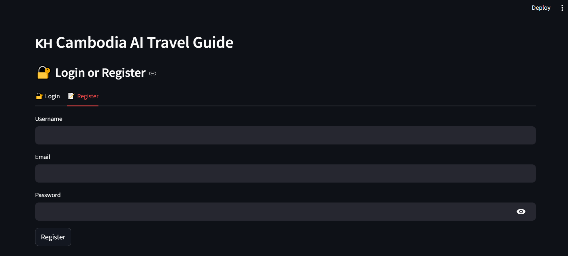
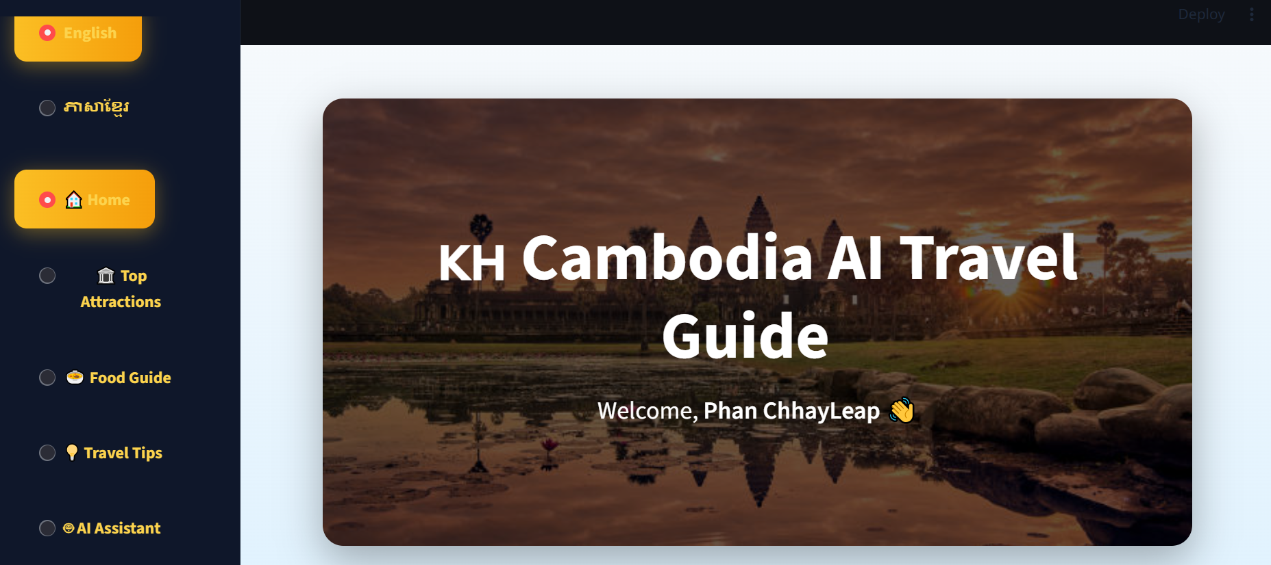
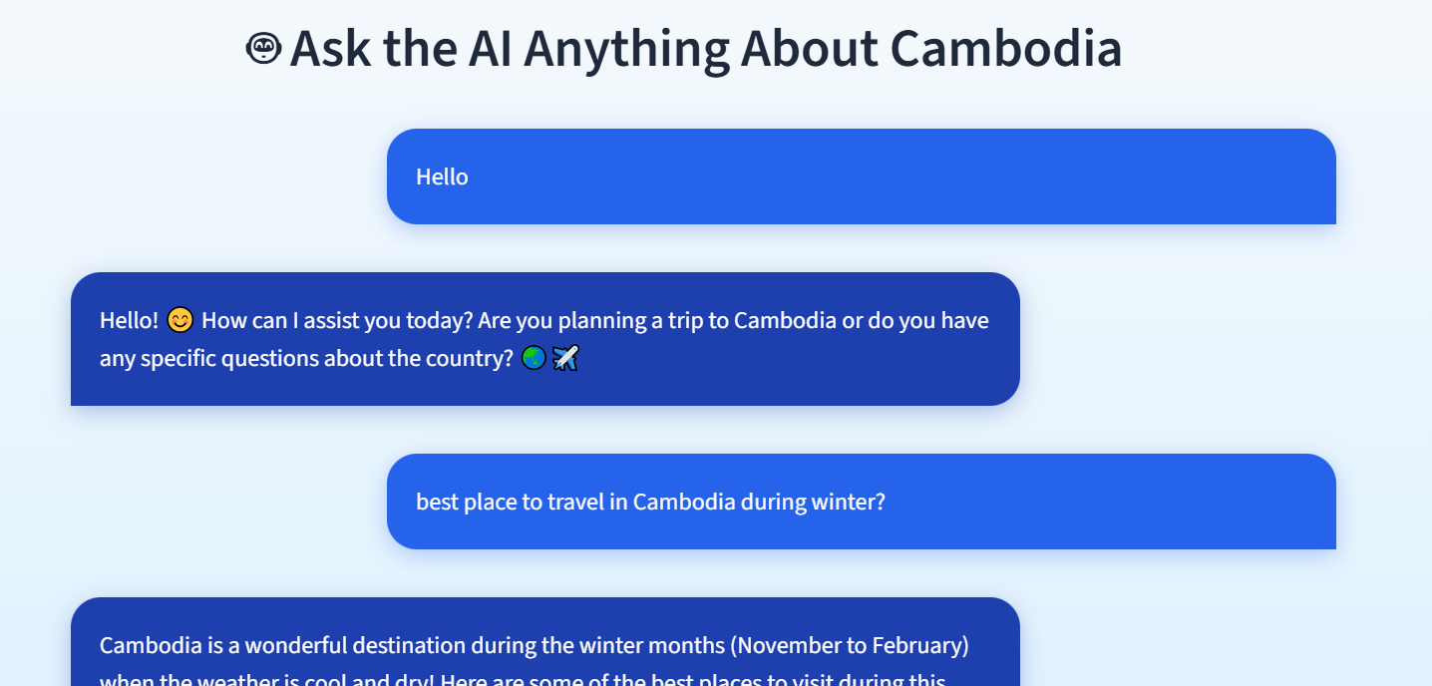
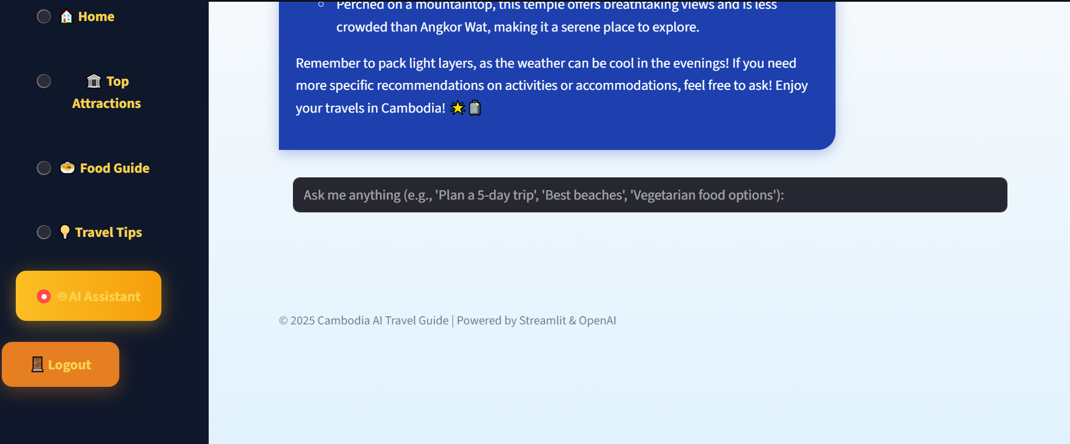
7. Testing Result (Result of Project)

Slide 16
8. CHALLENGES & SOLUTIONS (TECHNICAL HURDLES FACED)
Solutions
Improved NLP training
Structured tourist data
Continuous testing and refinement
User feedback integration
Challenges
Handling diverse user questions
Ensuring accurate tourism information
AI response consistency
Language understanding

Slide 17
9. CONCLUSION & FUTURE SCOPE
CONCLUSION
The AI Travel Guide Chatbot for Cambodia was successfully designed and developed.
The system provides instant, accurate, and personalized travel information to tourists.
It supports English and Khmer, helping overcome language barriers.
The chatbot enhances tourist experience and satisfaction through 24/7 AI assistance.
The project demonstrates how modern AI technology can support and promote Cambodia’s tourism industry.

Slide 18
9. CONCLUSION & FUTURE SCOPE
Future Scope
Mobile Application Development Android and iOS versions for wider accessibility
Voice-Based Chatbot Support voice input and output for hands-free interaction
Advanced Personalization AI recommendations based on user behavior, interests, and travel history
Map & Location Integration Integration with GPS and maps for navigation and nearby attractions
Booking & Service Integration Hotels, transportation, tours, and ticket booking
Real-Time Information Live updates on weather, events, traffic, and travel advisories
Expanded Language Support Improved Khmer support and additional international languages

Slide 19

THANK YOU
FOR YOUR ATTENTION
25 – December- 2025
vannymanuel333666999@gmail.com

